Slide 1
Mothers on the Rise: Advancing the HUMAN RiGHTs of Mothers experiencing INcarceration
Jack Turman, Jr., Ph.D.
Professor
Dept. of Social and Behavioral Sciences, Fairbanks School of Public Health
Dept. of Pediatrics, School of Medicine
Director, Grassroots MCH Initiative
Indiana University, Indianapolis
© Dr. Jack Turman Jr., Do not use without permission.

Slide 2
Starting with Gratitude…..
Riley Children’s Foundation
GMCHI Staff
Whitley Wynns, MA
Ashley Mager, MPH
Mackenzie Porter, MPH
Paige Klemme, PhD
Adam Mueller, JD, Indiana Justice Project
Indiana Dept. of Health
Private and Corporate Philanthropists
Funders
AmeriCorps
Nina Porter, Grassroots MCH Leader

Slide 3
Gratitude for Amazing Community Partners….
MOR Partners
IDOC
Healthy Families
Community Partners
Community Navigators
Mary Bullock, LCSW
IU McKinney Legal Clinic
Resources for Infant Educarers

Slide 4
Women: The Fastest Growing Prison Population
475% increase from 1980-2020 (The Sentencing Project, 2022)
80% of women incarcerated are mothers, responsible for care of their children (Swavola et al, 2016)
2000 children born to incarcerated women annually (Clarke and Adashi, 2011)
59% have history of substance use disorder (Wang et al., 2022)
Characteristics: 40% drug crimes, 40% Black, 16% Hispanic (aclu.org)
More likely to have mental health disorder than justice involved men, or women in general population
https://thecrimereport.org/2021/08/24/prisons-fail-to-address-needs-of-pregnant-incarcerees-report/
ICPA2022

Slide 5
Mothers and Babies in Prison
Indiana is one of 9 states with a nursery unit in its women’s prison - Officer Breann Leath Maternal and Child Unit (formerly Wee Ones Nursery)
From 3/2008-present: 365 women admitted to Nursery Unit/average of 24 annually
Transitional Healthcare Team
Largest prison nursery reported as there is no space restrictions
Only one with on-site pediatrics clinic
Little data on number of prisons with nursery programs
Participation in nursery programs:
Lower recidivism rates
Improve parenting efficacy
No adverse effects on children
Prevention of foster care placements (https://www.prisonlegalnews.org/news/publications/womens-prison-assoc-report-on-prison-nurseries-and-community-alternatives-2009/)
ICPA2022

Slide 6
Complexity of Mothers in the Justice System
Social, Economic, Environmental Conditions
Personal Traumas
Risk for Poor Social and Health Outcomes
Lack of Agency and Identity
Notes:
Talk about nursery unit, rates of poverty, addiction, DV abuse, ect.
Vulnerability= human right is not being met clearly- need to work at the systems level (in addition to individual too, obvi)

Slide 7
Community Realities Facing Mother/Baby Pairs
Complex web of services (location and context dependent)
Barriers to navigating and understanding this web of services
Lack of stable, safe housing
Return to poor social networks (domestic violence, triggers for substance use)
Social Stigma
Maternal Guilt and Lack of Parenting Skills (Robison and Hughes Miller, 2016)
https://hub.jhu.edu/magazine/2019/winter/pregnant-behind-bars-2501-em0-art1-nr-health-politics/
ICPA2022

Slide 8
Building on the Great Work of the Transitional Healthcare Team (THT) of the Indiana Dept. of Correction (IDOC)
Cares for Mother/Baby Pair in Leath Nursery and at release:
Food security services (WIC) transferred to county of release
All mom/baby pairs have active healthcare coverage, 30-day supply and 30-day script for mental health meds, 7 day and 30-day script for physical health meds
Expedited childcare vouchers, set up pediatric appointments, vaccination schedule, options for birth control
Provides car seat, safe sleep training (Pack N’Play Kit)
ICPA2022

Slide 9
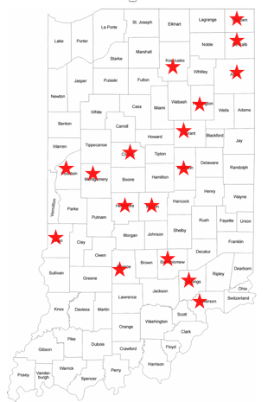
Who We Serve and Where
26 total mother/baby pairs over 30 months:
5 Mother/Baby pairs completed
21 Ongoing Mother/Baby pairs
Narcotics, theft, assault, prostitution
Back story: victims of domestic violence, child abuse/neglect, sexual assaults, poverty, social isolation
23 White/3 Black

Slide 10
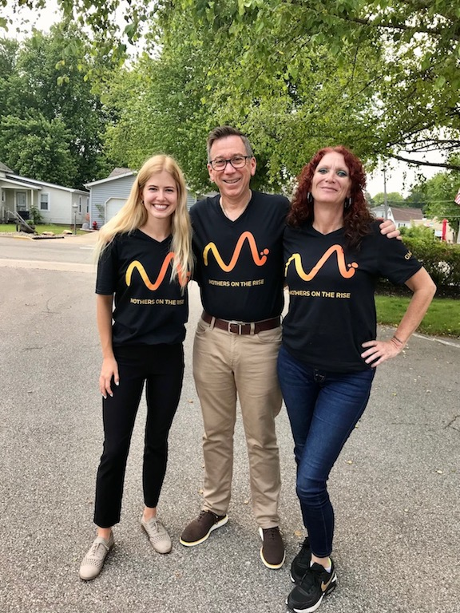
What We Do…. (Mager et al, 2022)
Application and Needs Assessment
Community Navigator Trained
Connect Mother to MOR Leadership team
Mother is Connected to Personal Service Team
Notes:
What actually happens, day to day

Slide 11
Our Service Team and Outreach
Mother/Baby Pair
MOR Program Manager
Community Navigator
Healthy Families
Community Partners
MOR Social Work Navigator
MOR Nurse Navigator
MOR Legal Navigator
Lead Community Navigator
Notes:
Since it it so complex, of a population, - and demographic- we needed to expand our partners, to increase the capacity of the right-holders and duty-bearers

Slide 12
Mothers’ Engagement with Our Positive Social Network
Utilization of Social Network
Who Mothers Engage with in the Network
On average women accessed 77% of their available Mothers on the Rise social network.
100% - program manager
100% - Local Community Navigator
91% - Mothers on the Rise Nurse Navigator
80% - Mothers on the Rise Social Work Navigator
64% - Lead Community Navigator
60% - Agency Home Visitor
52% - Agency Case Manager

Slide 13
How the Positive Social Network Meets Needs
Instrumental Needs | Emotional Needs | Resource Connections
100% women | 100% women | 100% women
Examples: Each mother/baby pair is provided $1000 in supplies upon release On average 26 items/mother-baby pair, laptop computer | Examples: Confide in team about stressors, celebrate success, relationship advice, engage in self-esteem, relationship training with social worker | Examples: Housing agencies, DCS prevention services, food pantries, educational opportunities, legal aid

Slide 14
Results: Mothers’ Engagement with Justice System
36 mother/baby pairs released since MOR initiated:
26 MOR Moms – 0% Recidivism Rate.
10 Non – MOR Moms – 2 returned to prison. (note: Most return to prison within 110 days (IDOC Statistics)
https://www.shethepeople.tv/news/what-do-women-want-a-day-to-celebrate-womanhood/

Slide 15
Results: Building the Capacity of Duty Bearers
Helping Correction’s Transitional Healthcare Team Expand their Services
Medical Roadmaps for Women in Prison: https://fsph.iupui.edu/doc/research-centers/FINAL-Health-Navitation-Roadmaps-for-Women-in-Prison_reduced.pdf
Implementing Maternal Standards of Care
Department of Children’s Services
Improved dissemination/coordination of services
Judicial Branch
Sentencing options
ICPA2022

Slide 16
Advancing Equity in Early Childhood Education Promises of Parenting Program
Incarcerated mothers are more likely to resume primary caregiver roles upon release (Bruns, 2006).
Implement trauma-informed, respectful, responsive, relationship-based care and education – Resources for Infant Educarers (RIE)

Slide 17
The Resources for Infant Educarers (RIE) Approach
Two generation approach
Caregiver presence
Sensitive observation
Respectful communication
RIE shown to:
Decrease parental stress
Increase parental confidence
Increase parent’s understanding of their child
(Richardson et al., 2020)

Slide 18
Initial Outcomes of Pilot - Weekly Session for 8 Weeks
4/6 moms (67%) increased parental confidence as measured by the Karitane Parenting Confidence Scale.
2/6 moms (33%) increased their maternal attachment inventory scores.
A RIE space within the nursery was created.
Foundational RIE toy bundles were provided to moms.

Slide 19
“I feel a stronger bond with him and like I’m doing something productive to be his parent, like I’m somebody he deserves. I feel like I’m doing right by him.”
-Promises of Parenting program participant

Slide 20
To Learn More….
Contact:
Jack Turman, Jr., Ph.D., Director, (jaturman@iu.edu)
317-278-0354 (office)
Visit and Follow Us:
Facebook, Twitter, & Instagram: @GrassrootsMCH
YouTube: https://rb.gy/umyp7u
LinkedIn: https://rb.gy/4wjlf6
NPR Marketplace: https://www.marketplace.org/2023/01/03/indiana-group-helps-mothers-recently-released-from-prison-find-housing-and-jobs/
APHA TV Turman Film: https://www.youtube.com/watch?v=RRE0W3jquwM&list=PL9CZabk3nD4HBRBttLBd4-KWgilWKPctl&index=17
© Dr. Jack Turman Jr., Do not use without permission.

