Slide 1
Wednesday, November 8th, 2023
We’ll kick off the meeting at 8:35!

Slide 3
Introduction of New Members

Slide 4
Leadership Transitions + Vacancies:
LCC Administrative Coordinator transition
LCC Executive Board – aka Substance Use subcommittee [responsible for managing LCC grant cycle and other Substance Use related projects] has multiple open member positions.
Suicide Prevention subcommittee is in need of a new leader.
Veterans subcommittee is in need of an additional co-leader.

Slide 5
2023-2025
Community Action Plan
Accomplishments

Slide 6
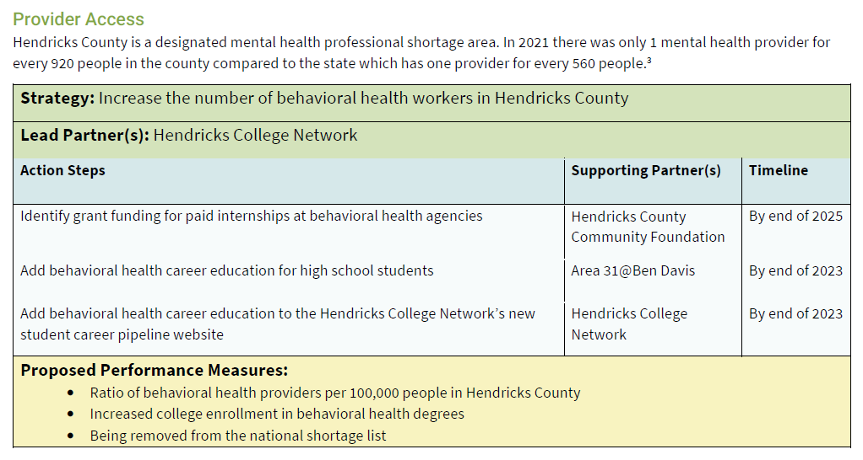
In Progress

Slide 7
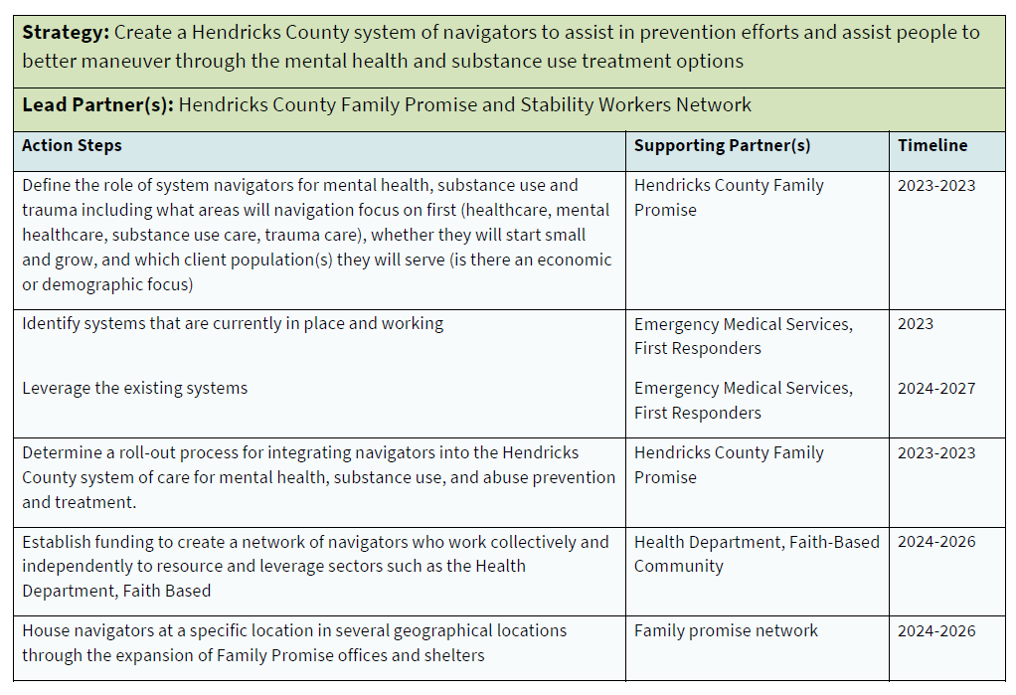
Complete
In progress
In progress
Complete
Complete
In progress

Slide 8
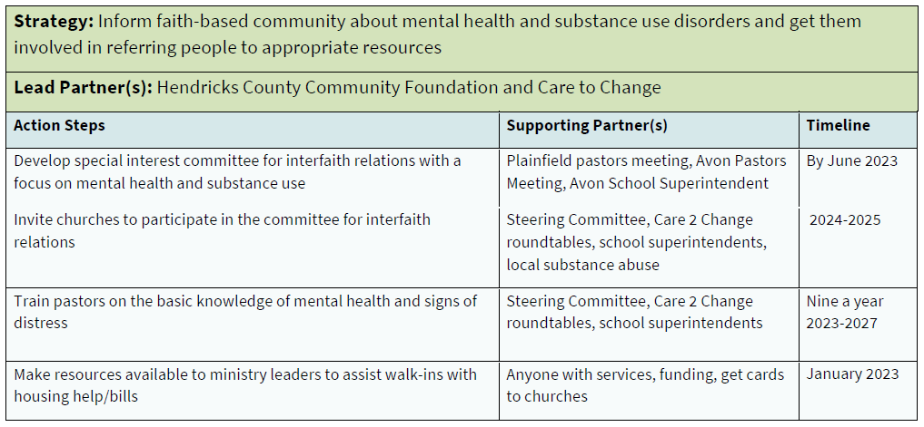
In Progress / Complete
In Progress / Complete

Slide 9
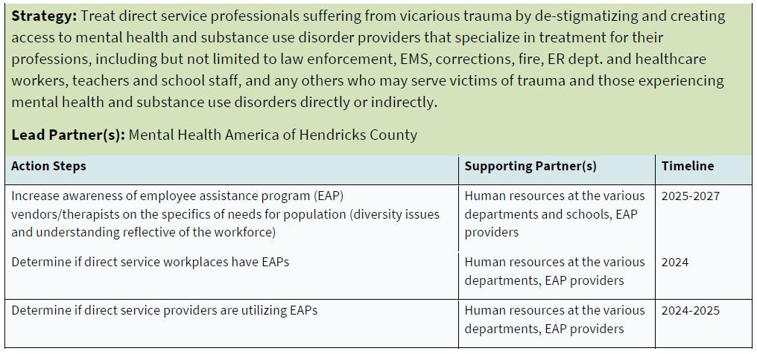
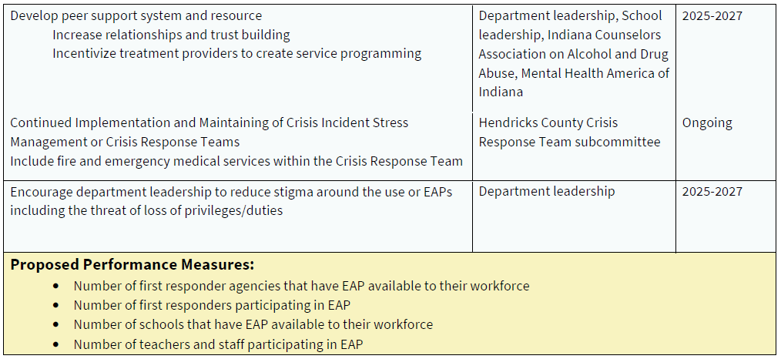
Complete / Ongoing

Slide 10
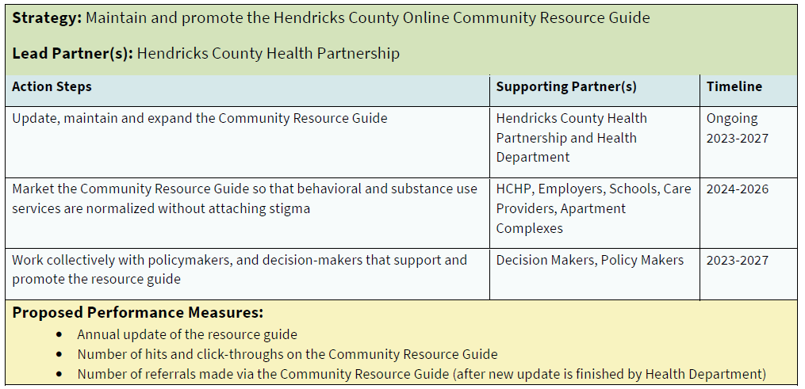
In Progress
In Progress / Ongoing

Slide 11
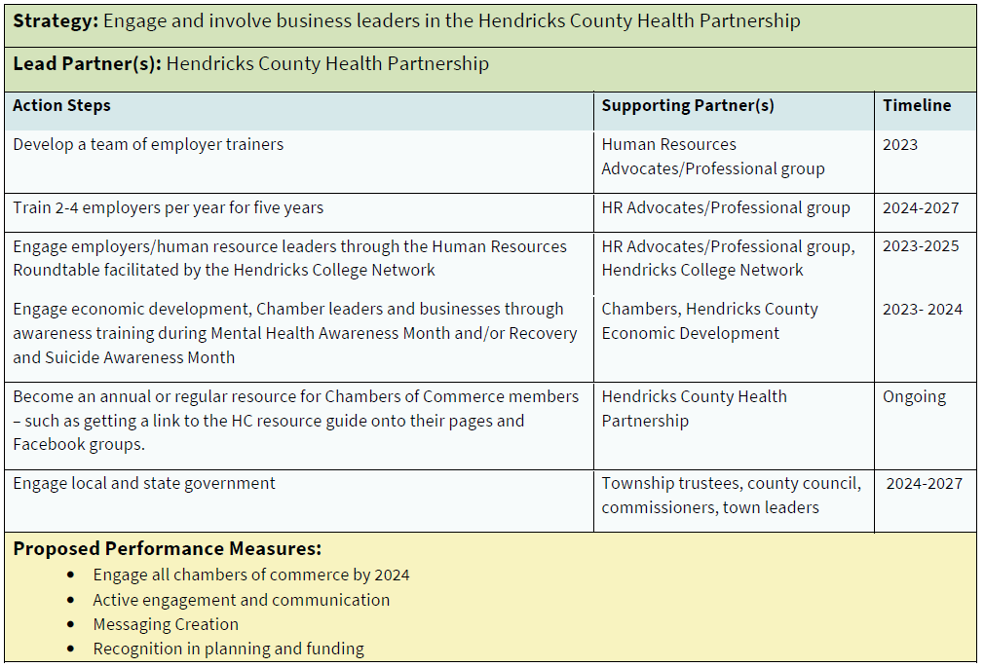
Complete
Complete/In Progress
Wellness Council of IN
In Progress
Ongoing
Ongoing

Slide 12
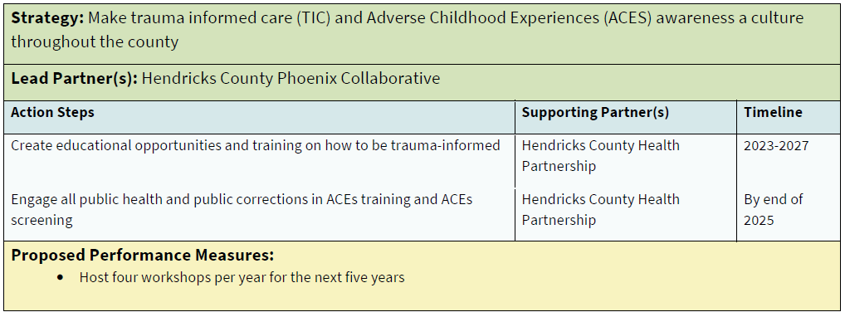
Complete / Ongoing
In Progress

Slide 13
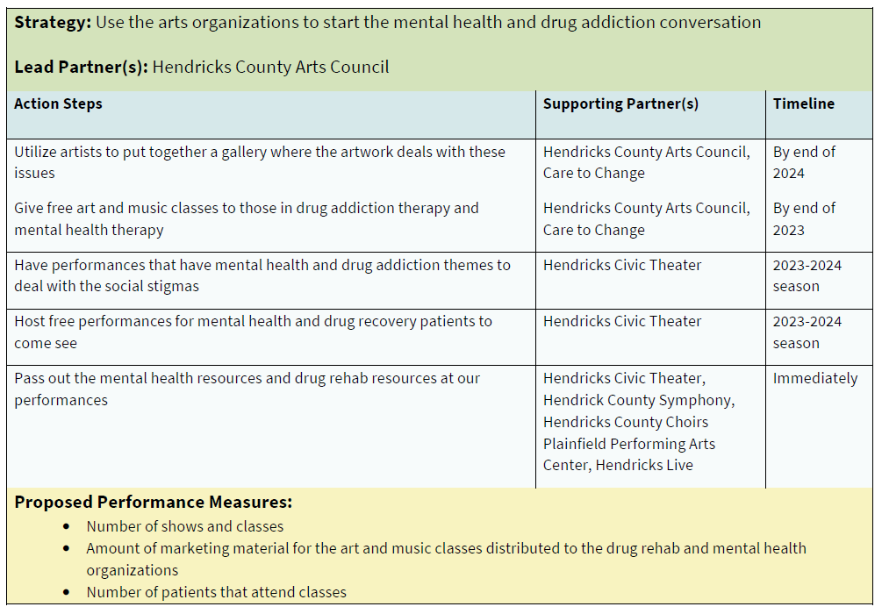
In progress
Complete

Slide 14
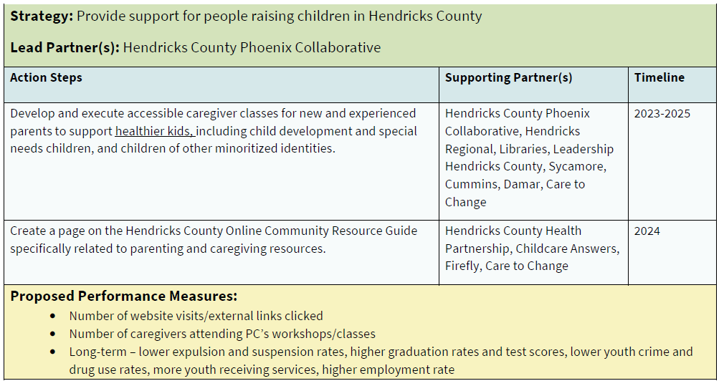
Complete / Ongoing
In Progress

Slide 15
Additional Accomplishments from 2023
MRC completed multiple CPR/BLS and Stop-The-Bleed Trainings – 300+ people trained, continuing in 2024
MHAHC hosting Veterans’ Luncheon + ongoing social club offerings
LCC Grant projects from February (ongoing)
Opioid Settlement Grant projects getting started throughout County and Towns
Thousands of individuals served through Food Pantry Coalition
Hundreds of individuals served through FPHC’s Stability Builders network
HC Pride Picnic success & HCAD events success

Slide 16
Open-floor Updates:
12/6 – Next IYI Youth Worker Café – Gun Violence & Prevention Strategies – Made@Plainfield 11:30am
2/7 -- IYI Hendricks County “Fuel Up” – Strategy and Network Meeting
Minkah Becktemba, Multiple Pathways to Recovery – Now accepting Medicaid for peer recovery support
HCHD is hiring for a Tobacco Prevention & Cessation Specialist – subcommittee rebooting in 2024

Slide 17
Hendricks College Network –
3 New Workforce Barrier Task Forces
Housing
Public Transportation
Childcare
If interested in joining/learning more, email Chris at HCN: chris@hendrickscollegenetwork.org

Slide 18
Next meeting – December 13^{th at 8:30am}
Strategizing / Planning for 2024 Projects

