Slide 1

Know the risks
A Youth Guide To E-cigarettes
Notes:
Today we are going to talk about e-cigarettes.

Slide 2


Quiz
Some
e-cigarettes
are safe for youth
Notes:
First, let’s get a sense about what you know about e-cigarettes already.
True or False – Some e-cigarettes are safe for youth.

Slide 3
Quiz
Some
e-cigarettes
are safe for youth
Notes:
FALSE. All e-cigarettes are unsafe for youth. We’ll talk about why today.

Slide 4
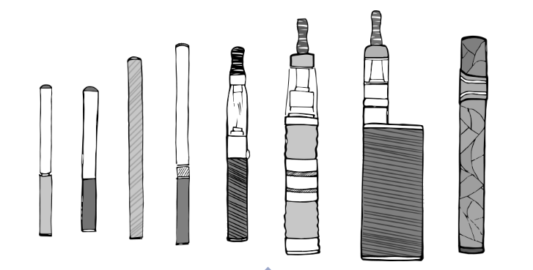



Topics 1
1
What Are
E-cigarettes?
2
2.
What Are The Health Risks?
3
What Leads
To E-cigarette Use?
4
What Can You Do About It?
Notes:
Today’s presentation will cover 4 main topics.
First, we’ll talk about what e-cigarettes are.
Next, we’ll talk about why they are dangerous to your health.
Then, we’ll look at the factors that lead to e-cigarette use in the first place.
Finally, we’ll talk about what you can do to avoid all tobacco products, including e-cigarettes, and how you can get involved to help others do the same.
Let’s start with, What is an e-cigarette?

Slide 5
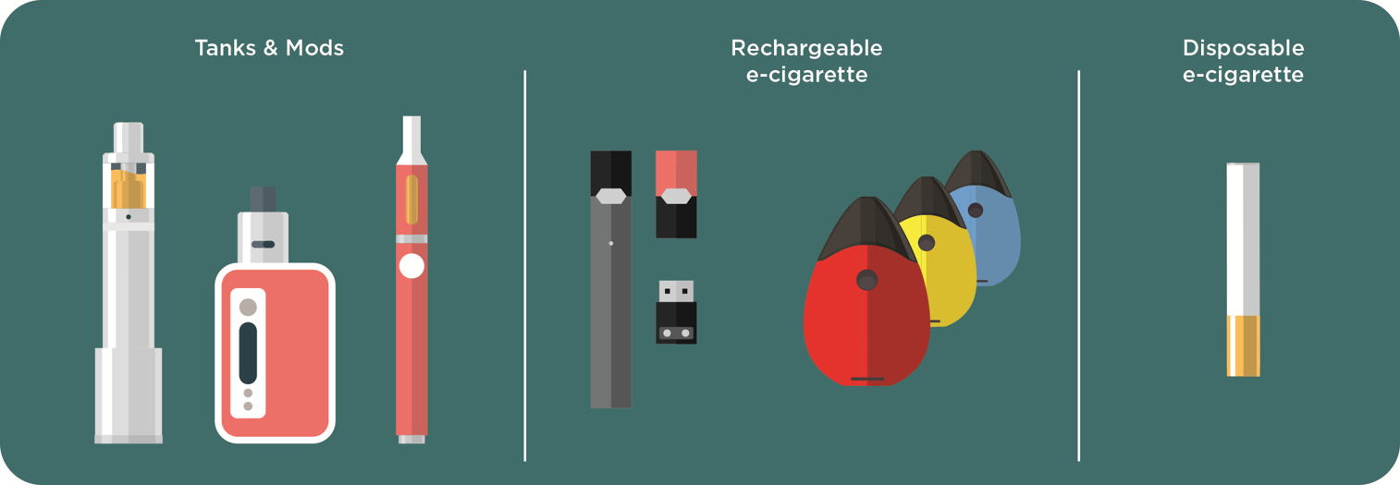

NO MATTER WHAT YOU CALL IT, IT’S AN E-CIGARETTE
Notes:
No matter what you call it, it’s an e-cigarette. E-cigarettes are known by many different names. You’ve probably heard them called “e-cigs” or “vapes” or just “JUUL.”

Slide 6

E-CIGARETTES COME IN MANY DIFFERENT SHAPES
E-cigarettes are devices that heat a liquid into an aerosol that the user inhales.
Notes:
E-cigarettes are devices that heat a liquid into an aerosol that the user inhales.
E-cigarettes come in lots of different shapes.
Some e-cigarettes look like regular tobacco products, such as cigarettes. But in recent years, we’ve seen e-cigarettes that look like other things, including USB flash drives, pens, and other everyday items. JUUL is one of the most common e-cigarettes shaped like a USB flash drive.
But regardless of what you call it, these are all e-cigarettes and none of them are safe for young people to use.

Slide 7
Quiz
Most
e-cigarettes contain nicotine
Notes:
Ok, thinking about what is in an e-cigarette, let’s check to see what you already know.
True or False - Most e-cigarettes contain nicotine.

Slide 8
Quiz
Most
e-cigarettes contain nicotine
Notes:
This is TRUE. Most e-cigarettes contain nicotine, which is the addictive drug in regular cigarettes and other tobacco products. According to the CDC, 99% of e-cigarettes contain nicotine. That is especially important for you to understand because nicotine can harm your brain, which continues to develop until you are about 25 years old.
We’ll talk more about that now.

Slide 9
Topics 2
1
What Are
E-cigarettes?
2
What Are The Health Risks?
3
What Leads
To E-cigarette Use?
4
What Can You Do About It?
Notes:
So now we know what e-cigarettes are and that they contain nicotine. So what? Why does this matter?

Slide 10
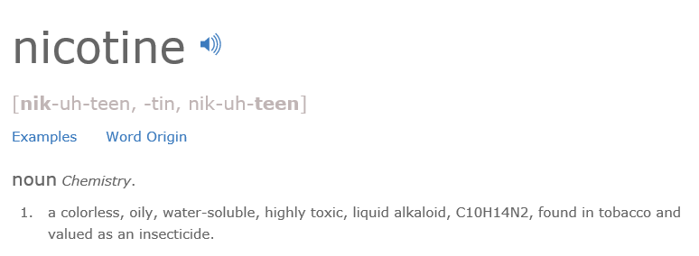
WHAT IS NICOTINE?
Notes:
Here you will see the dictionary definition of nicotine. We don’t expect you to know what all of these things are, but it’s important to have a basic understanding of what nicotine is before you can understand why using an e-cigarette is risky.
Nicotine is a drug found in tobacco plants. It’s also frequently used in insecticides to kill bugs. When you are hanging out with your friends, would you want to take a puff of insecticide?
Also, you should know that nicotine is the drug found in tobacco products that makes them addictive. That means that once you use it, your body will continue to want more.
When you use e-cigarettes, nicotine is quickly absorbed into your body and goes directly to your brain. Nicotine activates areas of the brain that make you feel satisfied and happy. Putting nicotine in your body is dangerously addictive, and it can also prime your brain for addiction to other tobacco products, or even harder drugs, like cocaine.

Slide 11
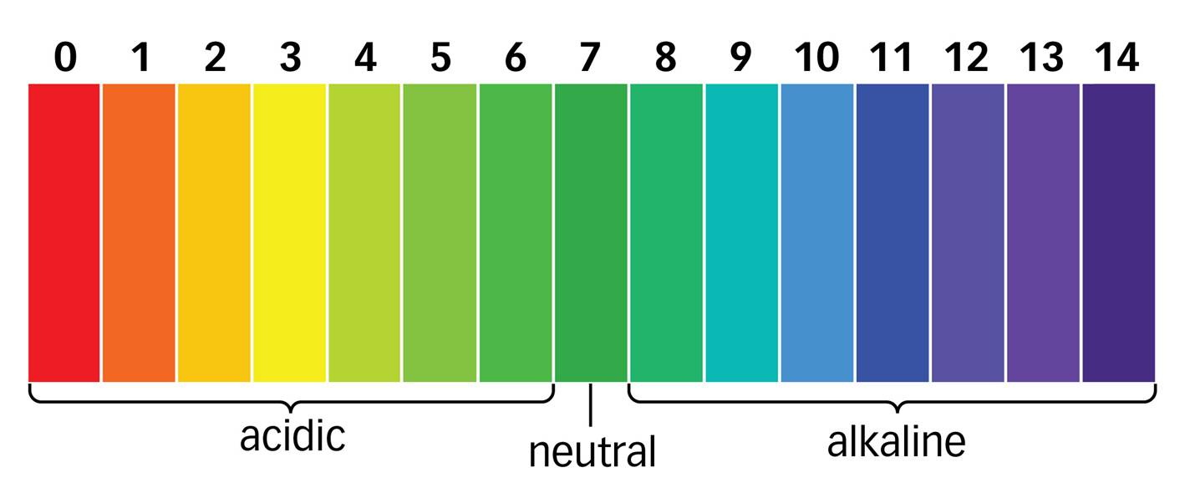
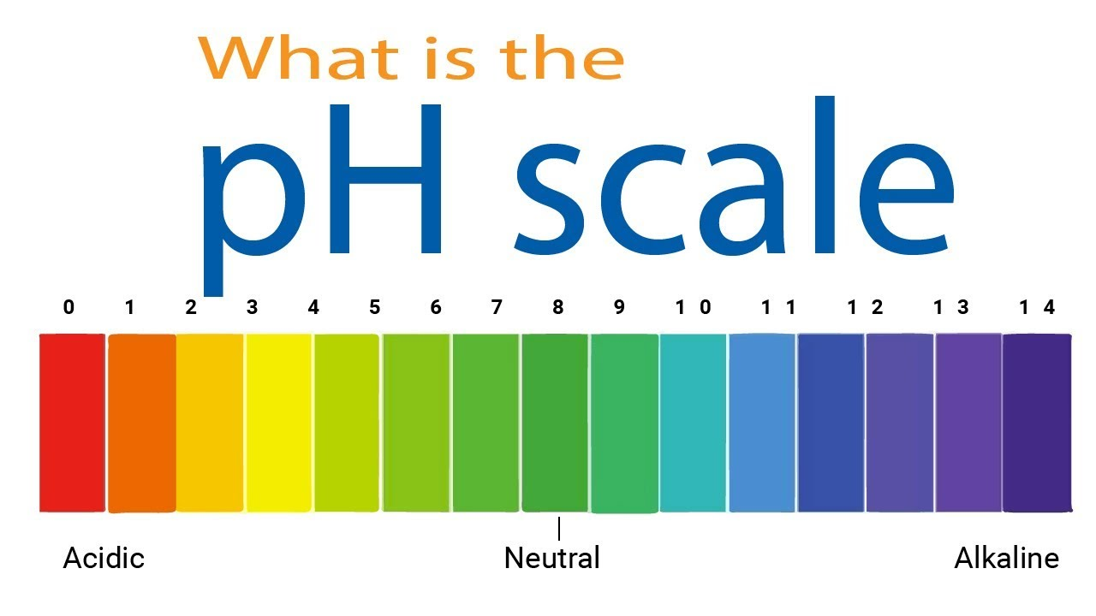

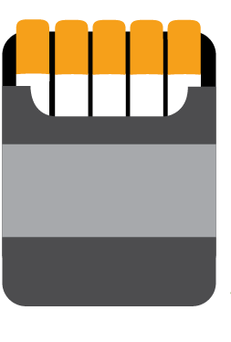
Nicotine Comes In Different Types
?
00
Free- Base Nicotine
Nicotine Salts
JUUL
Cigarettes
Notes:
So we’ve told you what nicotine is, but did you know there are different types of nicotine?
Some of you may have taken chemistry already, or you might be taking it in a few years. So you may know about the pH scale, which measures what chemicals are in liquids, such as in a swimming pool or a hot tub.
So why are we showing you this? Well, pH matters when it comes to how harsh nicotine is on your body, particularly your throat when you’re inhaling it.
Most nicotine in cigarettes and e-cigarettes is what we call free-base nicotine, which means it’s very blue on the pH scale. The more blue on the scale, the more volatile or crazy it’s going to be, which means that it will be harsher on your throat.
But get this: manufacturers of JUUL have found a way around the harshness factor. They added a chemical to the nicotine, which causes it to become more red on the pH scale. By making it more red, it then becomes what we call nicotine salts, rather than free-base nicotine.
Nicotine salts are less harsh on your throat. This is of particular concern for young people because it allows for nicotine to be used more easily, which increases the likelihood of trying an e-cigarette and getting hooked.

Slide 12
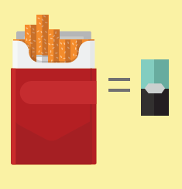

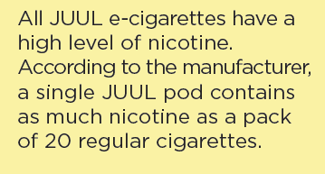
JUUL Contains a High Amount of Nicotine
Notes:
All JUUL e-cigarettes have a high level of nicotine – among the highest of e-cigarettes on the market.
JUUL’s nicotine liquid refills are called “pods.” A single JUUL pod contains at least as much nicotine as a pack of 20 regular cigarettes.
Some other brands have even more nicotine.

Slide 13
Quiz
Nicotine harms brain development
Notes:
Now that we’ve learned about the risks of nicotine, let’s talk about why that matters for your health.
In this section, we’ll talk about a variety of risks from e-cigarette use.
Let’s start with the brain.
Let’s check in again – True or False: Nicotine harms brain development.

Slide 14
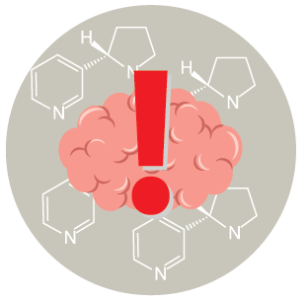
Quiz
Nicotine harms brain development
Notes:
The answer is TRUE.
Remember, most e-cigarettes contain nicotine, which is highly addictive and can harm brain development.

Slide 15

HOW DOES NICOTINE IN
E-CIGARETTES IMPACT THE BRAIN?
Youth who use nicotine can harm the parts of the brain that control attention, learning, mood, and impulse control.
Notes:
Right now, important growth is happening in each of your brains and will continue to happen until you are about 25 years old. The brain is the last organ in the human body to develop fully. Exposing your brain to nicotine while it’s in this important developmental phase can cause addiction and harm your brain.
Why? Think about it like this, each time a new memory is created or a new skill is learned, stronger connections – or synapses – are built between brain cells. Nicotine changes the way these connections, or synapses, are formed, which can harm the parts of the brain that control attention and learning.
Although adults may use nicotine products to quit, for youth, any exposure to nicotine is unsafe.

Slide 16
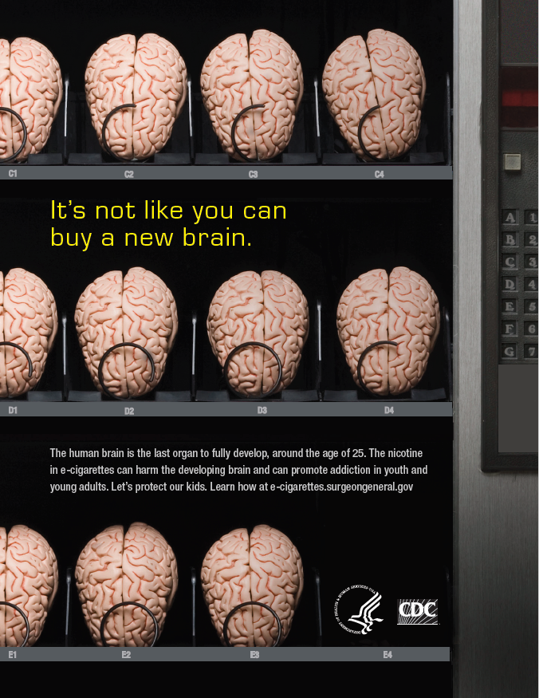

Nicotine Can Lead to Addiction
Notes:
So let’s talk about addiction.
Because addiction is a form of learning, young people can get addicted more easily than adults.
The nicotine in e-cigarettes and other tobacco products can also prime your brain for addiction to other drugs, such as cocaine.
And as the ad here says, it’s not like you can just go out and buy a new brain, so protect the one you have.

Slide 17


BEHAVIOR RISKS
Youth who use e-cigarettes may be more likely to smoke regular cigarettes in the future.
Notes:
Another risk in using e-cigarettes is that many youth who use them are more likely to go on to smoke cigarettes, even if they think they never will.
Use of two or more tobacco products is common among middle and high school youth. Many young people who use e-cigarettes also smoke cigarettes.
So the best thing to do to protect your health is to not use any tobacco product at all. No matter how it’s delivered – whether it be an e-cigarette or a cigarette - nicotine is harmful to your health.

Slide 18
Quiz
E-cigarettes create a harmless water vapor
Notes:
Let’s do another knowledge check: True or False: E-cigarettes create a harmless water vapor.

Slide 19
Quiz
E-cigarettes create a harmless water vapor
E-cigarettes create a harmless water vapor
Notes:
The answer is FALSE.
E-cigarettes allow the user to exhale clouds that many think are just “harmless water vapor.” The tobacco industry prefers the term “vapor” because this implies it is harmless. But it is not harmless.
E-cigarettes create an aerosol, which is a mixture of particles in the air, that can be harmful to your health.

Slide 20
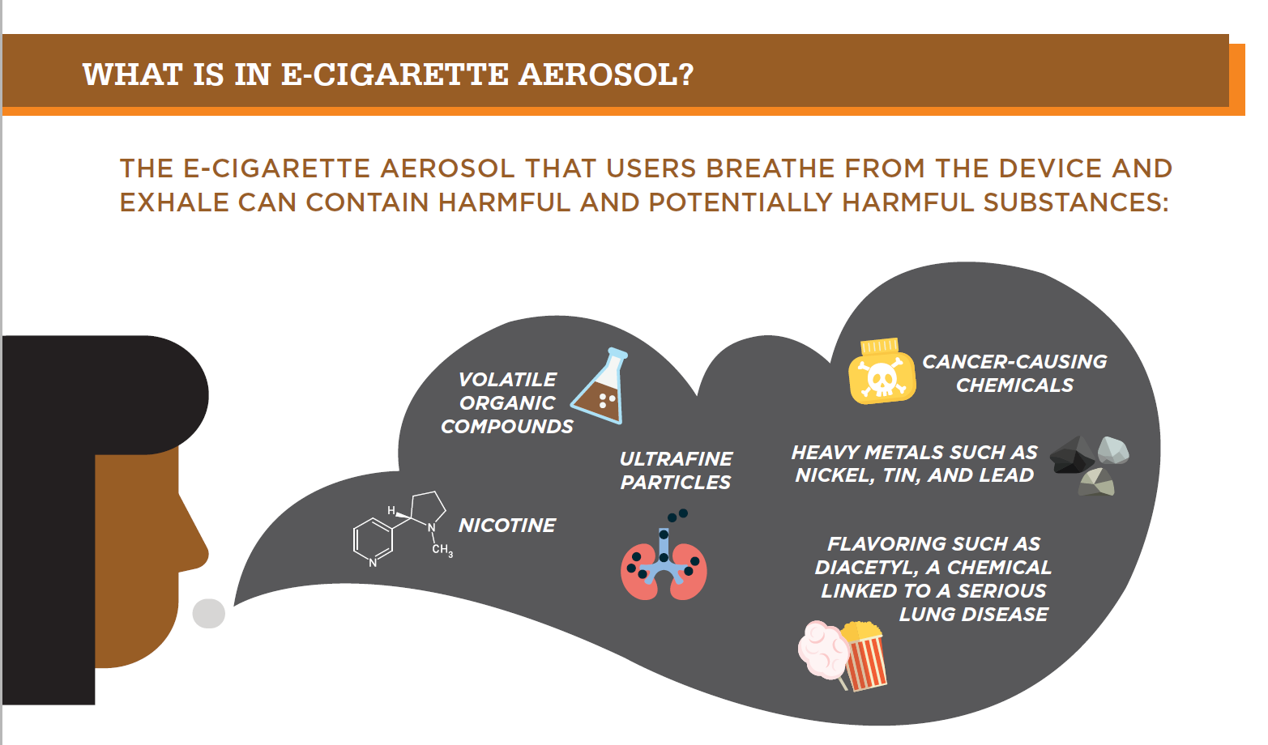

E-cigarettes Make Aerosol, Not Vapor
Notes:
Do you want to know what you are inhaling into your body when you use e-cigarettes?
Besides nicotine, e-cigarette aerosol can contain cancer-causing chemicals, heavy metals, and ultrafine particles that can be inhaled deeply into the lungs and harm your body.
And even though e-cigarette aerosol generally contains fewer harmful chemicals than regular cigarettes, safer doesn’t mean safe. This applies to both people using e-cigarettes, as well as people who may be exposed to secondhand aerosol from other people using e-cigarettes.
By the way, those flavorings in e-cigarettes aren’t necessarily safe either. Your gut can handle a lot more than yours lungs and flavorings in e-liquids or pods may not be safe when inhaled.

Slide 21
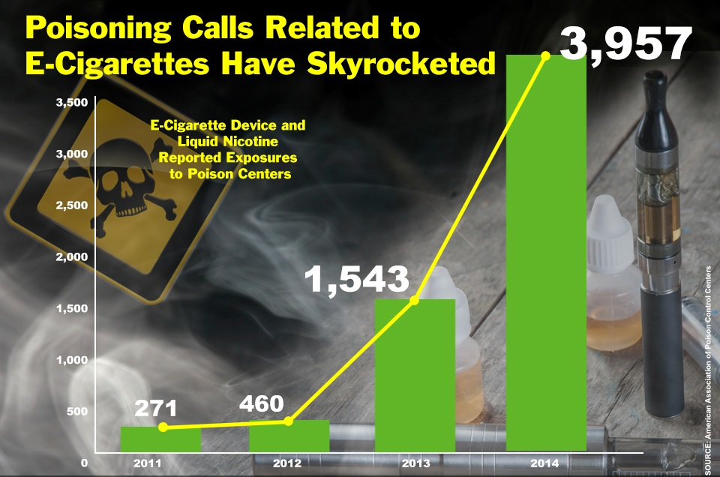

E-cigarette Poisonings
Source: American Association of Poison Control Centers
Notes:
And if that isn’t scary enough, even worse, children and adults have been poisoned by swallowing, breathing, or absorbing e-cigarette liquid through their skin or eyes.
Just look at the increase in calls to poison control centers across the country where people call for help when they’ve been exposed to poisons or other harmful things. Nearly 4,000 calls per year from e-cigarettes, and it’s increased over time.

Slide 22



Defective E-cigarette Batteries Can Cause Fires and Explosions
Notes:
And if potential poisoning wasn’t enough, defective e-cigarette batteries have caused fires and explosions, some of which have resulted in serious injuries. Most explosions happened when the e-cigarette batteries were being charged.
Here are some real-life examples. Don’t assume an e-cigarette device is safe.

Slide 23
Topics 3
1
What Are
E-cigarettes?
2
What Are The Health Risks?
3
What Leads
To E-cigarette Use?
4
What Can You Do About It?
Notes:
So what leads to e-cigarette use among youth?

Slide 24
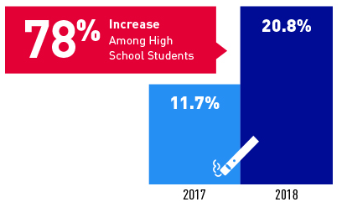
Surge in E-Cigarette Use Among Youth
Notes:
We know that e-cigarette use has risen among youth, particularly in the past year. Since 2014, e-cigarettes have been the most commonly used tobacco product among youth.
In the United States, youth are about seven times more likely to use e-cigarettes than adults!
But why is that happening?

Slide 25
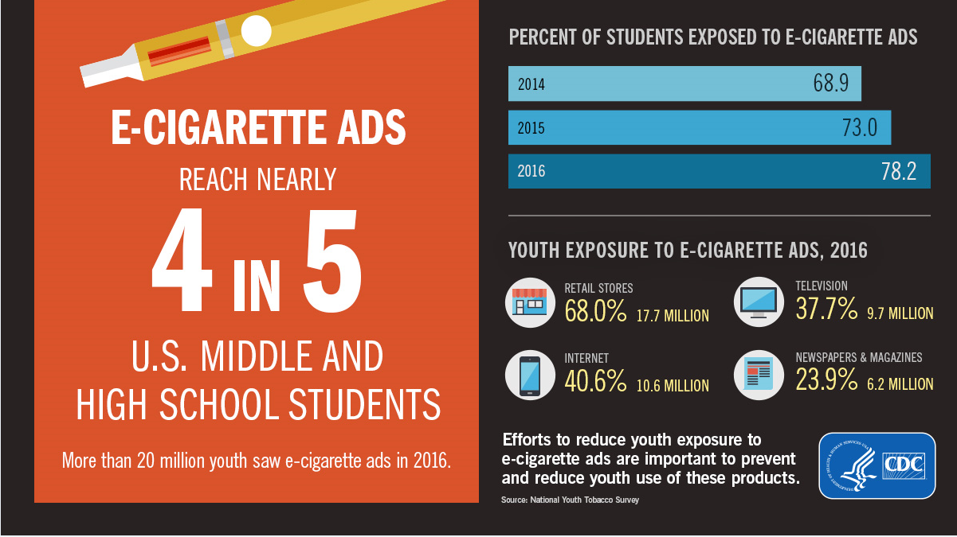

Youth Exposure To E-cigarette Advertising is Increasing
Notes:
Youth exposure to e-cigarette advertising is increasing.
One of the main reasons is advertising.
And these messages come in many different forms, whether it’s store signs, television ads, movies, the Internet, social media ads, magazines with cool images, or newspapers….it’s all around you.
E-cigarette ads reach nearly 4 in 5 middle and high school students, and youth exposure to these ads has increased in recent years.

Slide 26



Examples of E-cigarette Advertising
Sources: Marlboro ad on Google images , Vintage cigarette ads on Google images, JUUL billboard in NYC, blu eCig ad
Notes:
Don’t be fooled! E-cigarette companies are targeting you and making a lot of money off of it.
Here are a few examples of how they are doing it.
E-cigarette marketing ads are using themes including sexual content, independence, rebellion, and celebrity figures to appeal to youth and young adults. Signs like this one in the middle “JUUL sold here” are popping up at gas stations and convenience stores making it seem easily accessible.

Slide 27
Quiz
The tobacco industry is in the e-cigarette game
Notes:
Let’s do another knowledge check: True or False: The tobacco industry is in the e-cigarette game.

Slide 28
Quiz
The tobacco industry is in the e-cigarette game
Notes:
The answer is TRUE.
Big tobacco companies are moving to e-cigarettes to addict a new generation of users, including youth.

Slide 29



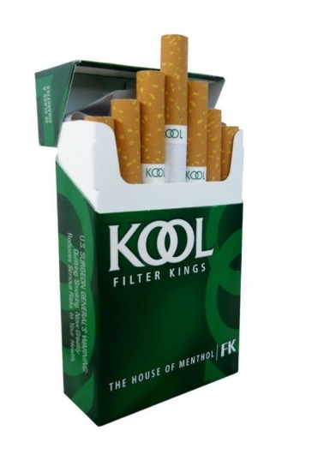
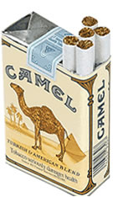
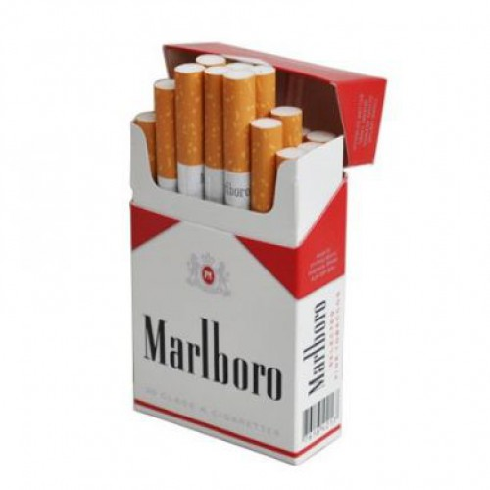
Same Players, New Products
Notes:
Some of the brands behind these new products are actually the same companies that produced traditional cigarettes.
For example, the company that sells Kool sells Blu, Marlboro sells Mark Ten, Camel sells Vuse.
Tobacco giant, Altria, maker of Marlboro cigarettes, paid $13 billion dollars to get in on JUUL.

Slide 30
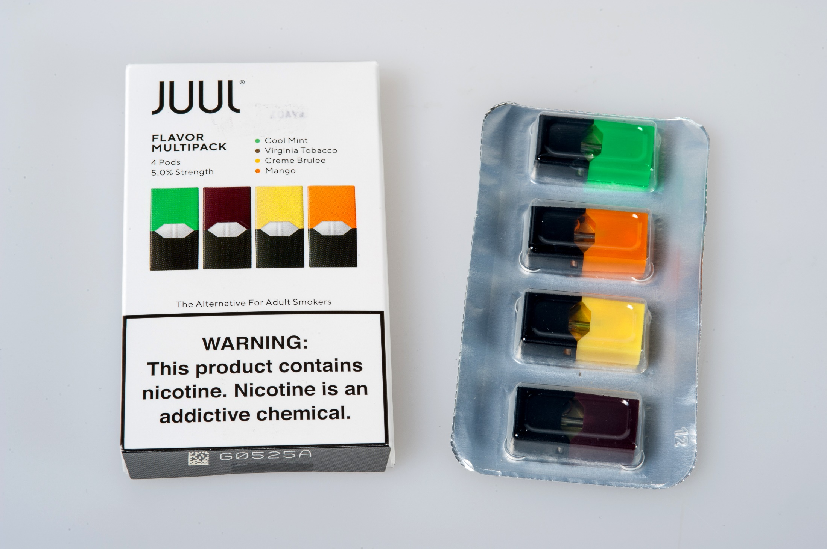
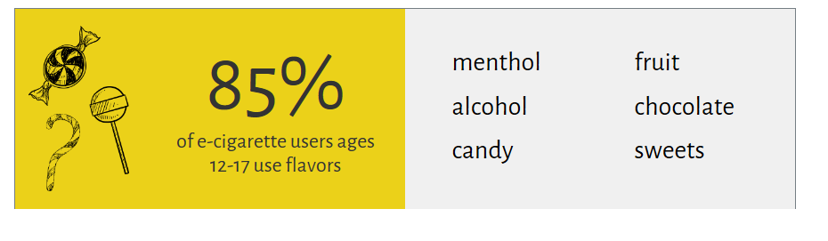
USE OF FLAVORS IS PROMINENT AMONG YOUTH
Source: U.S. Department of Health and Human Services.
E-Cigarette Use Among Youth and Young Adults: A Report of the Surgeon General—Executive Summary.
Notes:
In addition to advertising, we also know that flavors influence youth use. For example, many e-cigarettes contain fruit, candy, alcohol, or other flavors that youth find attractive and interesting.
Most of your peers who use e-cigarettes are doing so because of the appeal of flavors. And very few of them don’t use flavors.

Slide 31
Topics 4
1
What Are
E-cigarettes?
2
What Are The Health Risks?
3
What Leads
To E-cigarette Use?
4
What Can You Do About It?
Notes:
So, finally, what can you do about the problem of e-cigarettes?

Slide 32
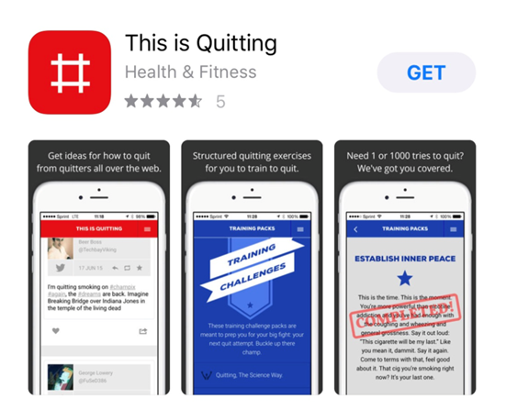
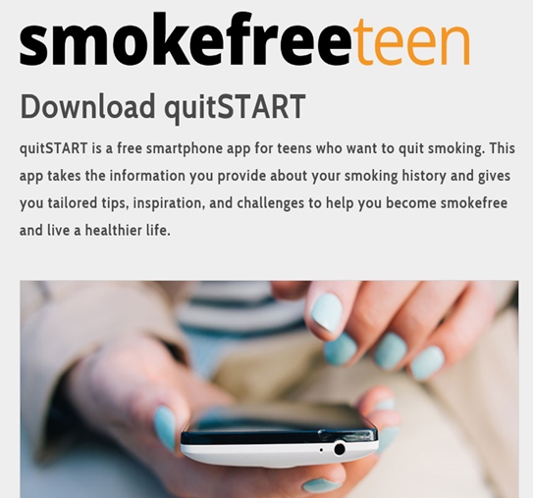

BE TOBACCO FREE!
“This is quitting” app
Teen apps
Ask for help!
Download the “This is quitting” app from Truth Initiative
Use the “quitSTART” app or “Smokefree TXT” for Teens from smokefree teen
Ask for help from family, friends, healthcare providers, and/or counselors.
Don’t give up.
Make a quit plan.
Notes:
If you haven’t started using tobacco, don’t start. Most teens DON’T use e-cigarettes or other tobacco products!
If you use e-cigarettes or other tobacco products, the sooner you quit, the better.
Here are some helpful resources to help you quit.
There’s the “This is quitting” app from Truth Initiative, quitSTART app or Smokefree TXT for Teens from smokefree teens dot gov.
Most importantly, get help, don’t do it alone.
Here are some things that you can do that will make a big impact on your quit journey:
Asking for help isn’t weak, it’s a smart move! If you feel comfortable, talk to friends or adults you trust about wanting to quit.
It’s normal for people to slip up when they’re trying to quit. If you slip up, don’t think of it as a failure. It just means you might want to try quitting in a different way.
Being prepared increases your chances of quitting successfully. Make a plan, stick to it, and keep trying to quit until you get it down.

Slide 33



AVOID SECONDHAND EXPOSURE
Notes:
Make sure you avoid secondhand aerosol, which we know can contain harmful ingredients.
Don’t let your friends, or anyone for that matter, smoke or use e-cigarettes around you.
You can also avoid restaurants and other locations that allow use of tobacco products, including e-cigarettes.

Slide 34

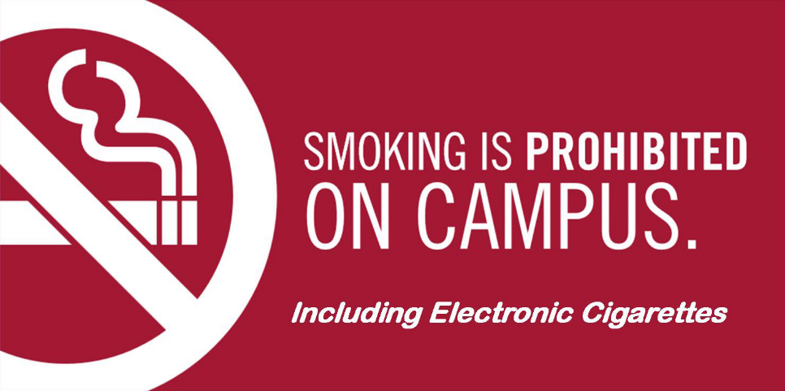
HELP YOUR SCHOOL GO TOBACCO FREE
Notes:
When it comes to your school, help your school go tobacco-free, if it’s not already.
Check with your school administration to ensure your school is completely tobacco-free, including being free of e-cigarettes, even after hours.

Slide 35


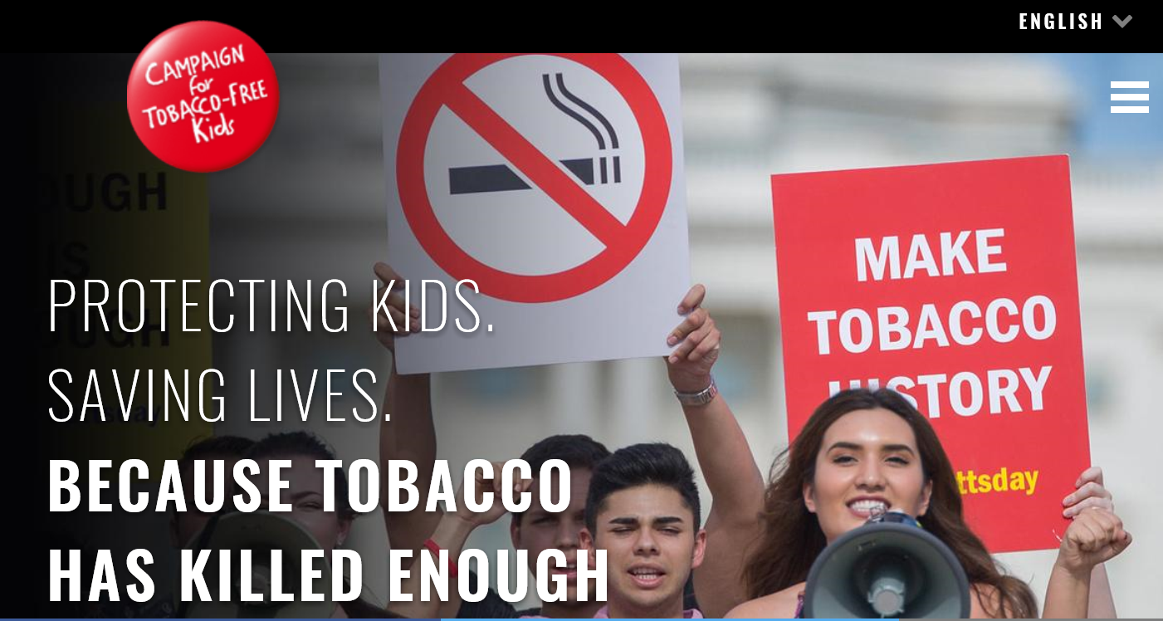
SPREAD THE WORD & GET INVOLVED!
Talk with your peers and community leaders about ways you can help educate your community about the dangers of e-cigarettes.
If you have friends that use e-cigarettes, talk to them about quitting.
Become an ambassador with The Campaign for Tobacco-Free Kids.
Notes:
You can also get involved!
Talk with your peers and community leaders about ways you can help educate your community about the dangers of e-cigarettes.
If you have friends that use e-cigarettes, talk to them about quitting.
You can also become an ambassador with the Campaign for Tobacco-Free Kids to make the next generation tobacco-free.

Slide 36
Topics 5
1
What Are
E-cigarettes?
2
What Are The Health Risks?
3
What Leads
To E-cigarette Use?
4
What Can You Do About It?
Notes:
Let’s recap what we learned today.

Slide 37
Topics 6
1
E-cigarettes ---
devices that heat a liquid into an aerosol that the user inhales
2
What Are The Health Risks?
3
What Factors Lead to Teen
E-cigarette Use?
4
What Can You Do?
Notes:
E-cigarettes are a tobacco product that produce an aerosol by heating a liquid that typically contains nicotine, flavorings, and other chemicals. They can come in many shapes and sizes.

Slide 38
Topics 7
1
E-cigarettes ---
devices that heat a liquid into an aerosol that the user inhales
2
Brain Development, Addiction, Behavior Risks, and Aerosol
3
What Factors Lead to Teen
E-cigarette Use?
4
What Can You Do?
Notes:
E-cigarettes typically contain nicotine, a highly addictive and harmful chemical that can harm your brain, which continues to develop until about age 25. Health risks include addiction, behavior risks, and exposure to the harmful ingredients in e-cigarette aerosol.

Slide 39
Topics 8
1
E-cigarettes ---
devices that heat a liquid into an aerosol that the user inhales
2
Brain Development, Addiction, Behavior Risks, Aerosol, and Defective E-cigarette batteries
3
Flavors and Advertising
4
What Can You Do?
Notes:
Advertising and flavors make young people use e-cigarettes.

Slide 40
topics 9
1
E-cigarettes ---
devices that heat a liquid into an aerosol that the user inhales
2
Brain Development, Addiction, Behavior Risks, Aerosol, and Defective E-cigarette batteries
3
Flavors and Advertising
4
Live
Tobacco-Free
Get Involved
Quit!
Notes:
Live tobacco-free, get involved, and quit if you are currently using any type of tobacco product, which includes e-cigarettes.

Slide 41
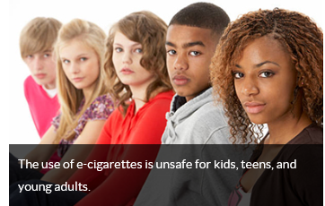
Final slide
Most Important Takeaway
Notes:
Don’t forget the most important takeaway from this presentation.
E-cigarette use poses a significant and avoidable health risk to YOU!

